Slide 1
Context & Your Task
The rest of this deck is a mock recitation section deck, inspired by real introductory CS slides (before we did an accessibility pass on the slide template). It also uses the “Blue & Gold” built-in Google Slides theme.
Your task:
Make a copy of the slide deck
Identify at least 3 different accessibility issues
Try to fix at least one accessibility issue fully, across all slides

Slide 2
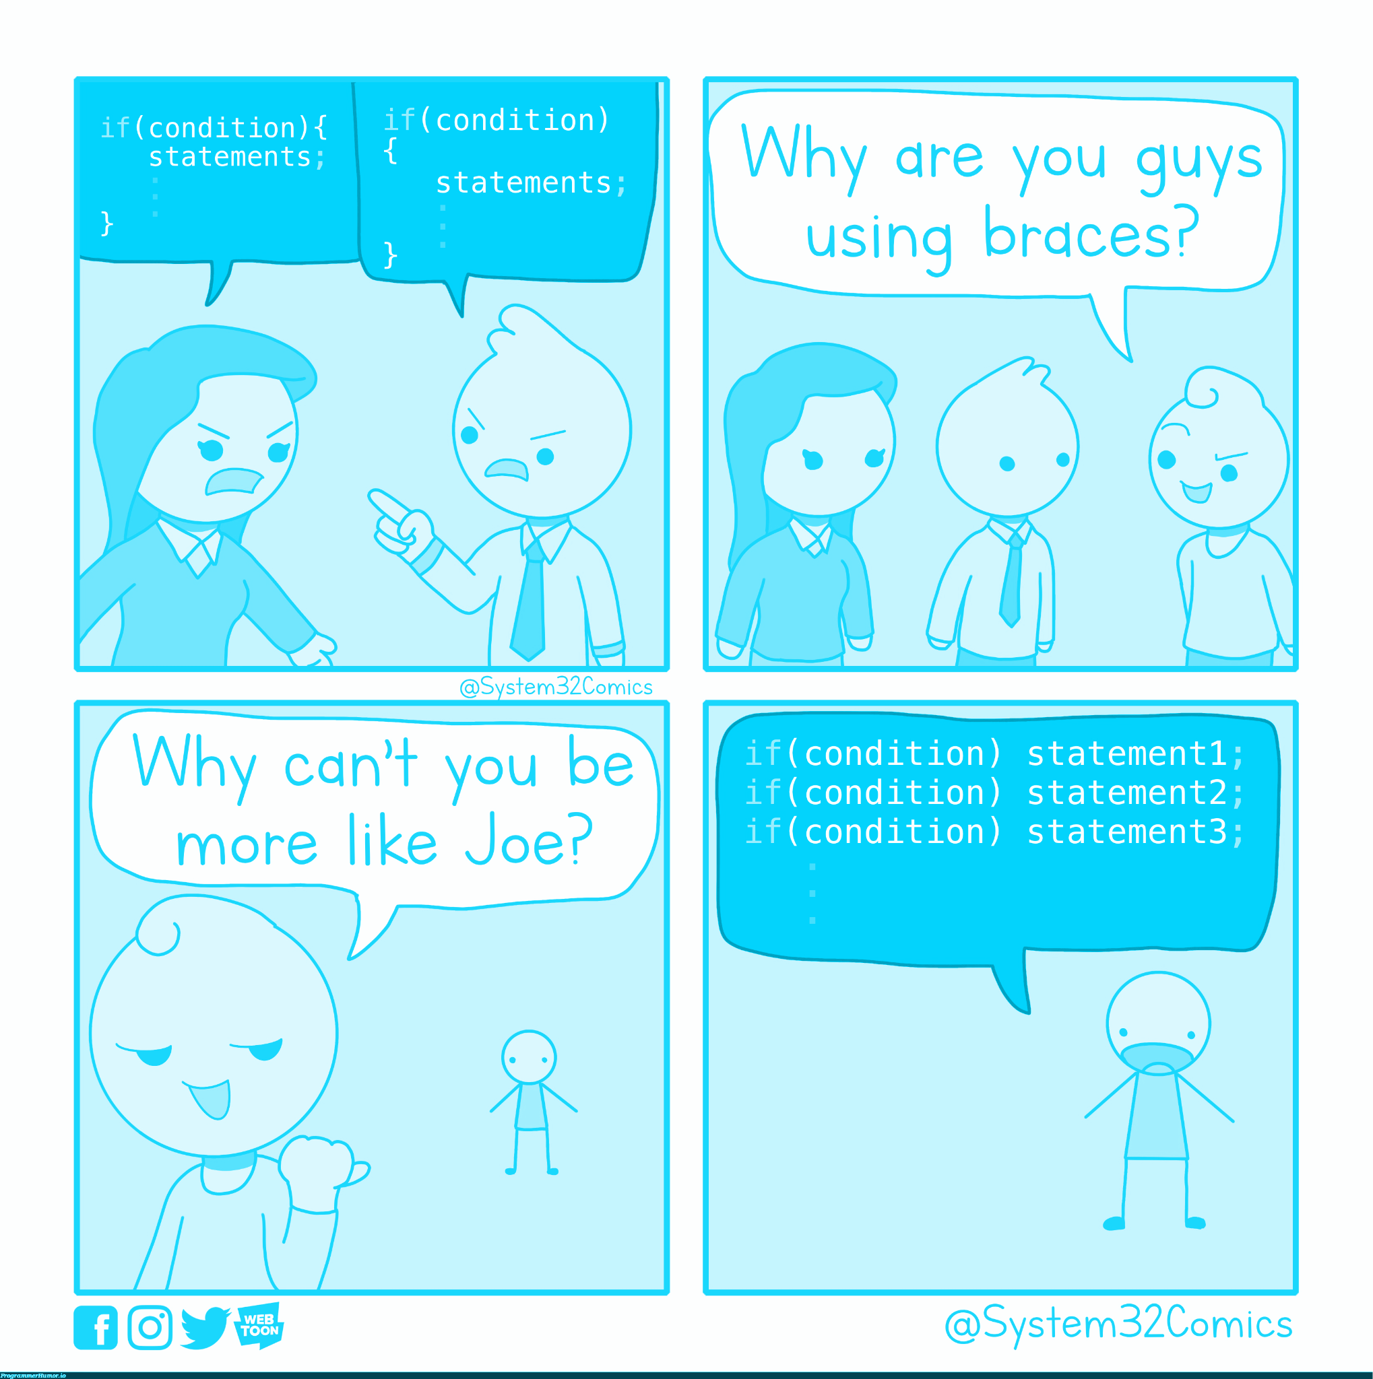
Conditionals
Introductory Computer Science
Section 4
credit

Slide 3
Announcements and Reminders
Quiz 1 is next week! See practice quiz (link) and extra review (link)
Thursday: programming assignment 1 is due!
Friday: creative project 2 is out
Reminder: grading rubrics are on the course website

Slide 4
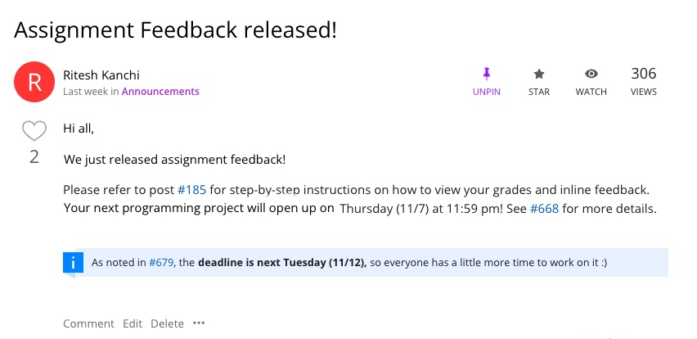

Slide 5
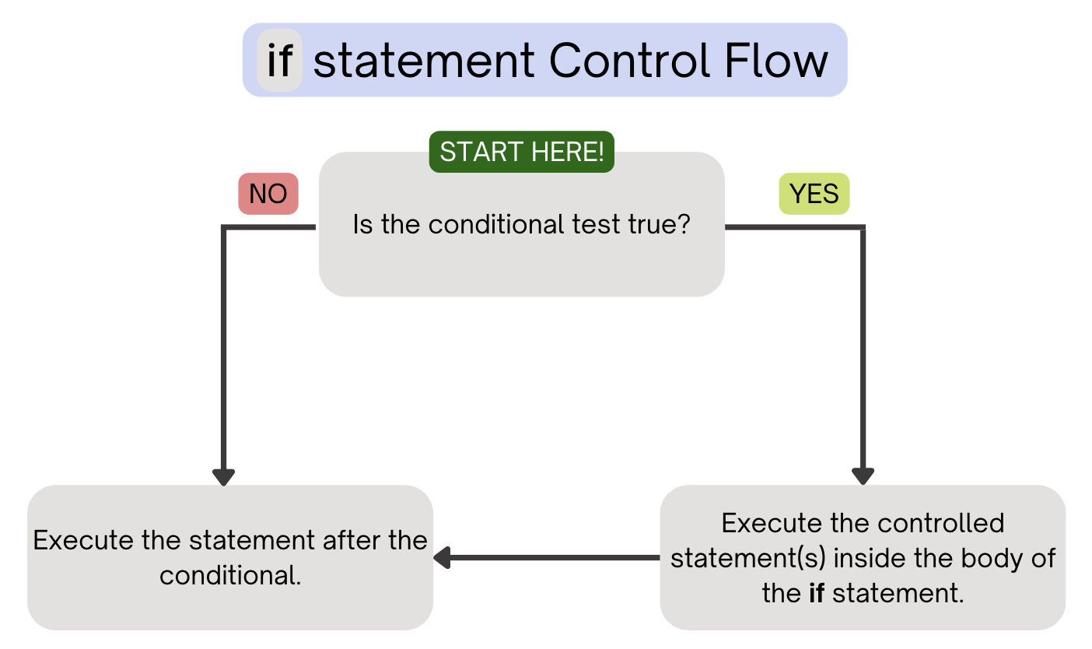
Review

Slide 6
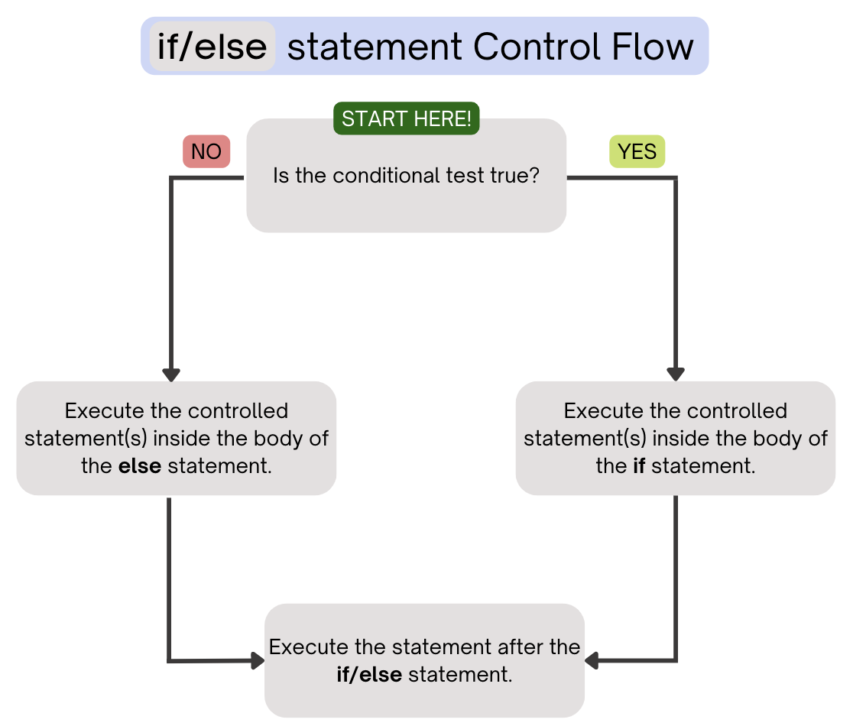
Review

Slide 7
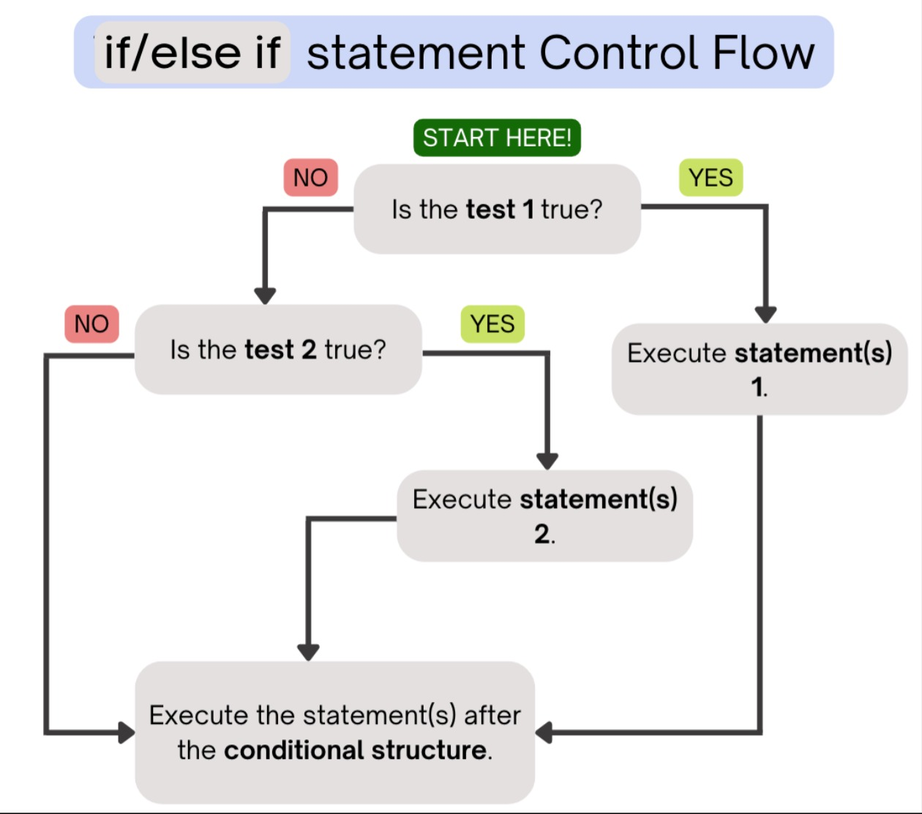
Review

Slide 8
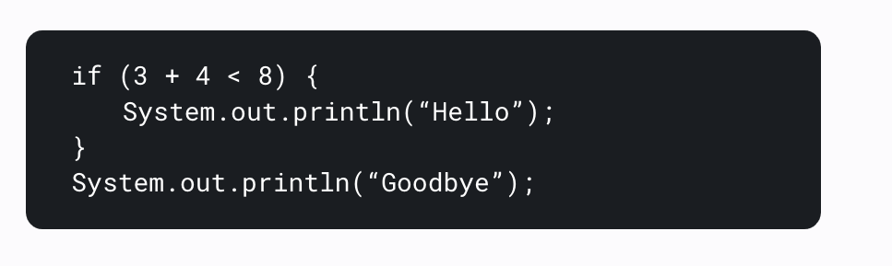
Example
What’s printed below?

Slide 9
Example
What’s printed here?
Hello
Goodbye

Slide 10
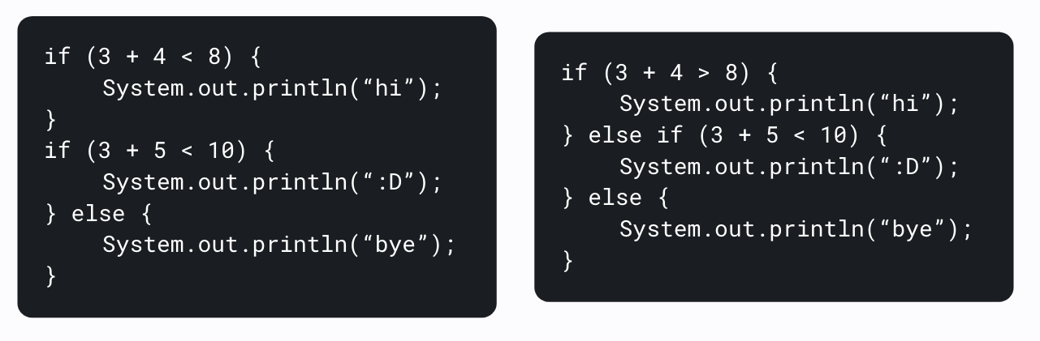
Example
One thing that makes if statements so powerful is their ability to be chained together, using the else if keyword! What’s printed below?

Slide 11
Example
One thing that makes if statements so powerful is their ability to be chained together, using the else if keyword! What are printed in these examples?
hi
:D
:D

Slide 12
Tracing through an example
So far, we’ve only looked at small conditional statements that involve numbers.
But, big programs (like the ones you will write later) can have long and complicated conditionals!
Let’s try tracing through another example, which focuses on strings and numbers.

Slide 13
public class Example {
public static void main(String[] args) {
String dayOfWeek = "Wednesday";
if (dayOfWeek.equals("Monday")) {
System.out.println("Beginning of the week! :)");
} else if (dayOfWeek.equals("Wednesday")) {
System.out.println("Hump day! XD");
} else if (dayOfWeek.equals("Saturday") || dayOfWeek.equals("Sunday")) {
System.out.println("The weekend! WOOHOO!");
} else if (dayOfWeek.equals("Friday")) {
System.out.println("Almost the weekend :D");
} else {
System.out.println("How many days until Friday? -_-");
}
}
}

Slide 14
public class Example {
public static void main(String[] args) {
String dayOfWeek = "Wednesday";
if (dayOfWeek.equals("Monday")) {
System.out.println("Beginning of the week! :)");
} else if (dayOfWeek.equals("Wednesday")) {
System.out.println("Hump day! XD");
} else if (dayOfWeek.equals("Saturday") || dayOfWeek.equals("Sunday")) {
System.out.println("The weekend! WOOHOO!");
} else if (dayOfWeek.equals("Friday")) {
System.out.println("Almost the weekend :D");
} else {
System.out.println("How many days until Friday? -_-");
}
}
}
First, we check this – which is false, so we move on

Slide 15
public class Example {
public static void main(String[] args) {
String dayOfWeek = "Wednesday";
if (dayOfWeek.equals("Monday")) {
System.out.println("Beginning of the week! :)");
} else if (dayOfWeek.equals("Wednesday")) {
System.out.println("Hump day! XD");
} else if (dayOfWeek.equals("Saturday") || dayOfWeek.equals("Sunday")) {
System.out.println("The weekend! WOOHOO!");
} else if (dayOfWeek.equals("Friday")) {
System.out.println("Almost the weekend :D");
} else {
System.out.println("How many days until Friday? -_-");
}
}
}
Next, we check this else if, which is true

Slide 16
public class Example {
public static void main(String[] args) {
String dayOfWeek = "Wednesday";
if (dayOfWeek.equals("Monday")) {
System.out.println("Beginning of the week! :)");
} else if (dayOfWeek.equals("Wednesday")) {
System.out.println("Hump day! XD");
} else if (dayOfWeek.equals("Saturday") || dayOfWeek.equals("Sunday")) {
System.out.println("The weekend! WOOHOO!");
} else if (dayOfWeek.equals("Friday")) {
System.out.println("Almost the weekend :D");
} else {
System.out.println("How many days until Friday? -_-");
}
}
}
So, we run the code in the else if

Slide 17
public class Example {
public static void main(String[] args) {
String dayOfWeek = "Wednesday";
if (dayOfWeek.equals("Monday")) {
System.out.println("Beginning of the week! :)");
} else if (dayOfWeek.equals("Wednesday")) {
System.out.println("Hump day! XD");
} else if (dayOfWeek.equals("Saturday") || dayOfWeek.equals("Sunday")) {
System.out.println("The weekend! WOOHOO!");
} else if (dayOfWeek.equals("Friday")) {
System.out.println("Almost the weekend :D");
} else {
System.out.println("How many days until Friday? -_-");
}
}
}
After, we jump to the end – we do not run the else if or else

Slide 18
public class Example {
public static void main(String[] args) {
String dayOfWeek = "Friday";
if (dayOfWeek.equals("Monday")) {
System.out.println("Beginning of the week! :)");
} else if (dayOfWeek.equals("Wednesday")) {
System.out.println("Hump day! XD");
} else if (dayOfWeek.equals("Saturday") || dayOfWeek.equals("Sunday")) {
System.out.println("The weekend! WOOHOO!");
} else if (dayOfWeek.equals("Friday")) {
System.out.println("Almost the weekend :D");
} else {
System.out.println("How many days until Friday? -_-");
}
}
}
In this case, we have to look at BOTH the saturday and sunday cases because of ||

Slide 19
Practice problem time!
Let’s spend 10min on today's problem. Try to use those spec reading skills we talked about!

Slide 20

thank you!!
have a good week :)

